Slide 1
Ankle Fractures
Nyakure

Slide 2
Injury patterns
isolated medial malleolus fracture
isolated lateral malleolus fracture
bimalleolar and bimalleolar-equivalent fractures
posterior malleolus fractures
Bosworth fracture-dislocations

Slide 3
Radiographs
external rotation stress radiograph
most appropriate stress radiograph to assess competency of deltoid ligament
a medial clear space of >5mm with external rotation stress applied to a dorsiflexed ankle is predictive of deep deltoid disruption
more sensitive to injury than medial tenderness, ecchymosis, or edema
gravity stress radiograph is equivalent to manual stress radiograph
syndesmosis
decreased tibiofibular overlap
normal >6 mm on AP view
normal >1 mm on mortise view
increased medial clear space
normal less than or equal to 4 mm
increased tibiofibular clear space
normal <6 mm on both AP and mortise views
radiographic measurements
talocrural angle
measured by bisection of line through tibial anatomical axis and another line through the tips of the malleoli
shortening of lateral malleoli fractures can lead to increased talocrural angle
talocrural angle is not 100% reliable for estimating restoration of fibular length
can also utilize the realignment of the medial fibular prominence with the tibiotalar joint

Slide 4
Clinical presentation
Symptoms:
-Swelling , pain, lose of use
Signs:
-Tenderness
-swelling
-loss of function

Slide 5
Classifications
Lauge hansen: SER, PER, SA, PA
2. Anatomic / Descriptive
isolated medial or lateral malleolar
bimalleolar
trimalleolar
Bosworth fracture-dislocation (posterior dislocation of the fibula behind incisura fibularis)
3. Danis-Weber (location of fibular fracture)
A - infrasyndesmotic (generally not associated with ankle instability)
B - transsyndesmotic
C - suprasyndesmotic
4. AO / ATA
44A - infrasyndesmotic
44B - transsyndesmotic
44C - suprasyndesmotic

Slide 6
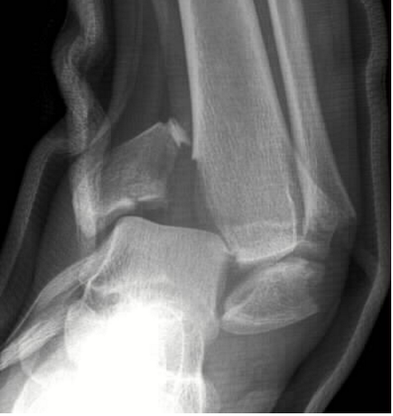
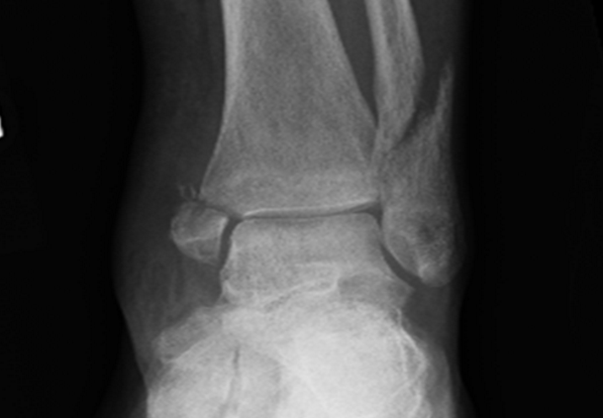
Classification
Supination adduction
Supination external rotation

Slide 7
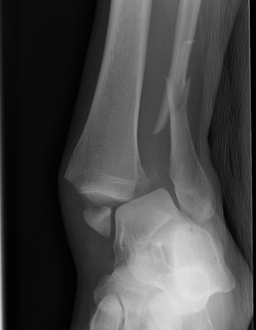
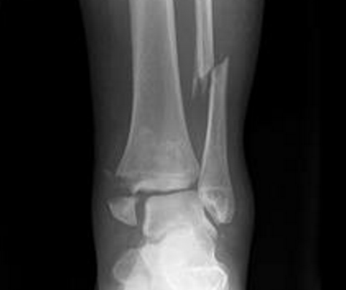
Classification
Pronation abduction
Pronation external rotation

Slide 8
Non operative treatment
short-leg walking cast/boot
indications
isolated nondisplaced medial malleolus fracture or tip avulsions
isolated lateral malleolus fracture with < 3mm displacement and no talar shift
posterior malleolar fracture with < 25% joint involvement or < 2mm step-off

Slide 9
Operative
open reduction internal fixation
indications
any talar displacement
displaced isolated medial malleolar fracture
displaced isolated lateral malleolar fracture
bimalleolar fracture
posterior malleolar fracture with > 25% or > 2mm step-off
Bosworth fracture-dislocations
open fractures

Slide 10
Complications
Wound dehiscence
Deep infections
Post-traumatic arthritis
Malunion

